Slide 1
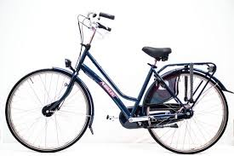
Bike Data
Data Analytics Capstone
How do annual members and casual riders use Cyclistic bikes differently?

Slide 2
PREPARE
Data Collection & Storing the information
Data was acquired randomly via
https://divvy-tripdata.s3.amazonaws.com/index.html#:~:text=202304%2Ddivvy%2Dtripdata.zip

Slide 3
PROCESS
Cleaning & Checking the information
Out of 767650 observation, the dataset was narrowed down to 109513 observation using Excel. The following were eliminated:
Blank entries
Station ID that begin with a letter - for consistency purposes

Slide 4
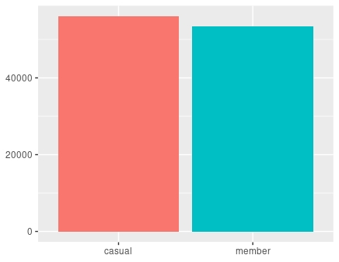
ANALYZE
Explore the data
For the month of July, casual and member riders use the bikes about the same amount of times

Slide 5

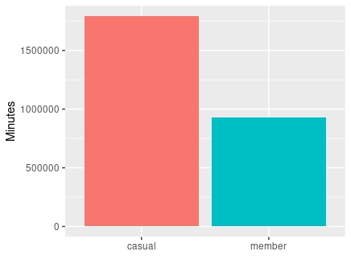
Minutes Utilized
Casual riders ride the bikes three times more than the members in minutes, even though they both almost equally use the service.

Slide 6
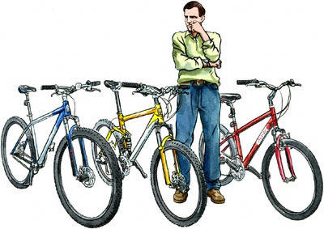
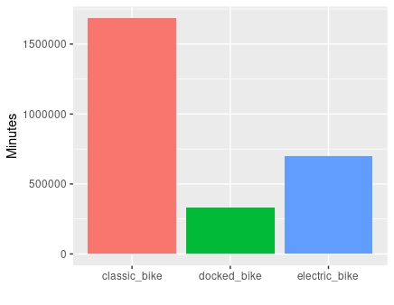
Minutes per type of bike
Between the three different types of bikes, the classic bike is being ridden the most at over 1,500,000 minutes

Slide 7
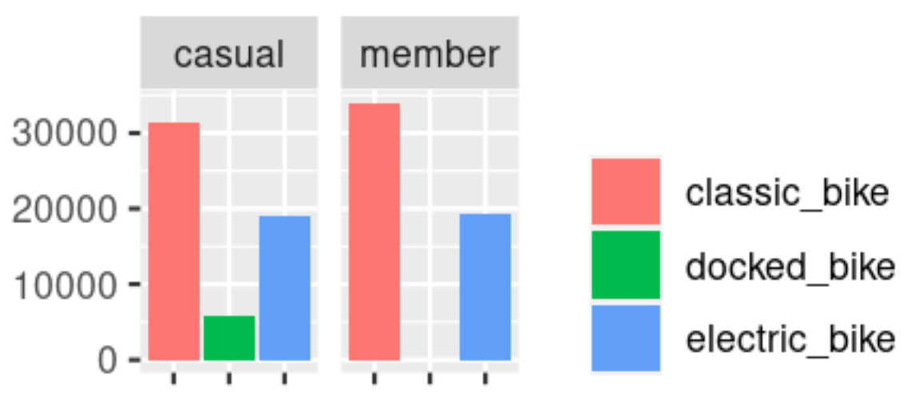
Type of bike per user
The classic bike is being utilized the most by both type of users. The casual rider will utilize the docked bike as oppose to the member rider

Slide 8
When comparing how many times the casual and the member rider rents a bike, it is about the same. The data does not show if each time it is a new rider, or the same rider getting a bike several different times a day.
Two keys ways how member and casual riders use Cyclistic bikes differently:
Casual riders ride the bike longer than the members
Casual riders will utilize the docked bikes
The available data is incomplete because it is missing the price of renting the bike, number of bikes that are available throughout the day, demographic of the riders is not available, is it a new customer renting a bike, or the same person renting multiple times a day.

